Slide 1
DOMAIN DRIVEN DESIGN AND IMPLEMENTATION OF MUSIC STORE BASED ON .NET WEB
QIU JUAN

Slide 2
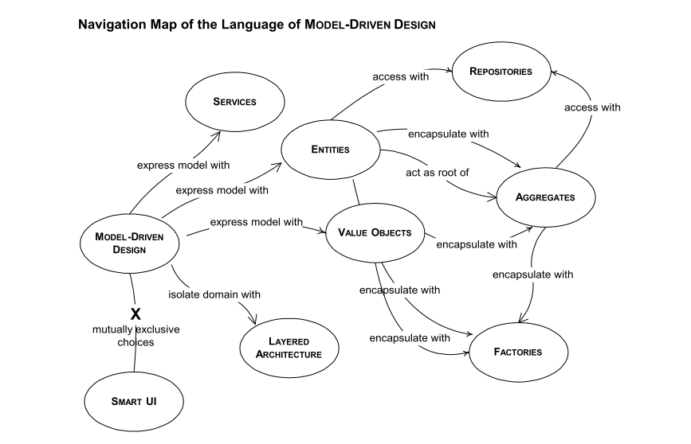
DDD

Slide 3
UBIQUITOUS LANGUAGE
A project needs a common language that is more than the lowest common denominator.
the domain model can provide the backbone for that common language, while connecting team communication to the software implementation. That language can be ubiquitous in the teams work.

Slide 4
DDD Architecture
Onion Architecture vs N-Tier

Slide 5
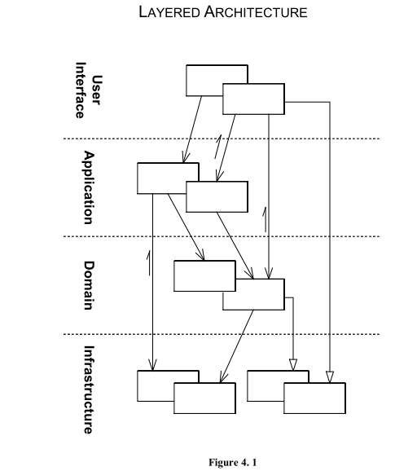
LAYERED ARCHITECTURE

Slide 6
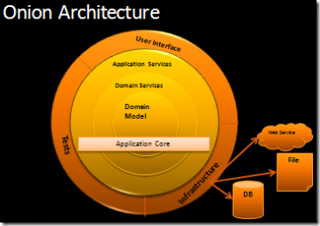
Onion Architecture
http://jeffreypalermo.com/blog/the-onion-architecture-part-1/

Slide 7
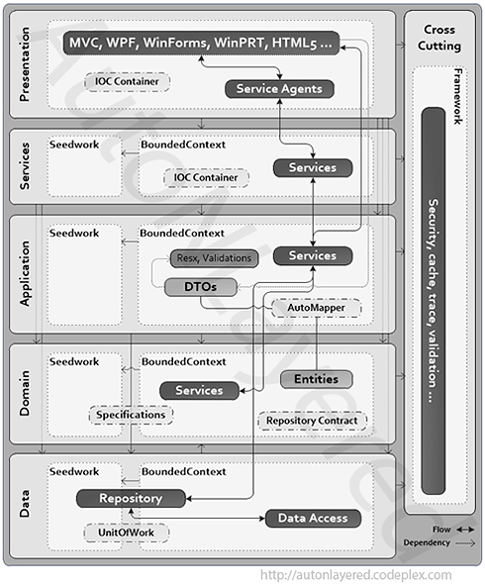
Microsoft N-Layered DDD Architecture
https://autonlayered.codeplex.com/

Slide 8
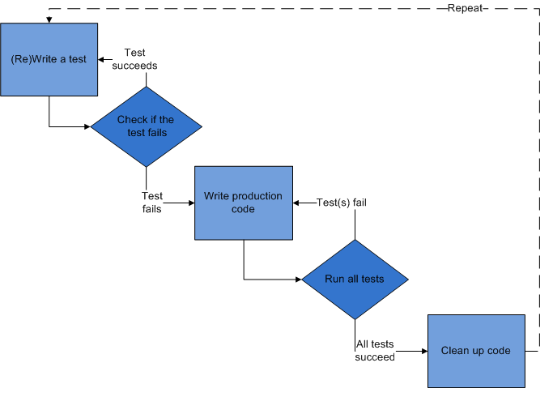
TDD

Slide 9
BDD
Given a 5 by 5 game
When I toggle the cell at (2, 3)
Then the grid should look like ..... ..... ..... ..X.. ..... When I toggle the cell at (2, 4)
Then the grid should look like ..... ..... ..... ..X.. ..X.. When I toggle the cell at (2, 3)
Then the grid should look like ..... ..... ..... ..... ..X..

Slide 10
Demo
Demo…

Slide 11
Thank You

